Slide 1
Evaluating a behavioural science approach to increasing the take up of advice services offered to residents in economic hardship
Vicky Powers
Derbyshire County Council

Slide 2
Opportunity and challenge
Opportunity
Derbyshire’s Local Welfare Assistance Fund (Derbyshire Discretionary Fund) is a key touchpoint - speaks with Derbyshire’s most vulnerable residents, at a critical point.
27k calls, ½ callers from 20% most deprived areas, ~40% of calls could be prevented with better financial management.
Improve signposting and referrals to support
Preventative opportunity - shift from ‘head in the sand’ to ‘engagement’
Build relationships with partners (big picture) - joined up approach between agencies.
Challenge
DDF was signposting to Citizens Advice / other agencies - but not tracking data or outcomes ‘off into the ether’
Time pressured call, the callers were focused on the immediate decision (present biased), information wasn’t landing (cognitive load, linked with debt).
Welfare Rights internal referral data showed that contact was not always made, (38% dropped), despite repeat calls.

Slide 3
Local Government Association (LGA) Behavioural Insights Project
Apply behavioural insights to a range of local government challenges.
&
Introduce and embed a behavioural science approach.
DDF Project
To apply behavioural insights to increase caller referrals to support agencies. Increasing support accessed by vulnerable residents.
To use an evidence based approach to evaluate the impact of any interventions - Randomised Controlled Trials (RCT).
To help prove the value and effectiveness of a behavioural science approach.
Notes:
Surveys were in January

Slide 4
Project Overview
Scoping Phase - To establish feasibility and initial concepts
COVID-19 - Paused and reviewed feasibility
Delivery Phase
Identify & build partnership relationships
Project Management - GDPR / Ethics sign off
Design and launch 3 trials
Citizens Advice - Completed
Welfare Rights - Completed
Money Sorted - Low referral numbers
Analysis & Write up
Final Report - Draft 1 being reviewed

Slide 5
Referral process - behaviour change
REFERRAL TRIALS
Increased focus and awareness on referrals. Through
meetings, raffles
Providing Feedback to DMs
Case Studies on impact
Reinforces behaviour
Mosaic System. Call management system
Provide prompts in the call process
Increasing DM agency
Only referring ‘engaged’ callers, DM judgement is important.
Screening and Decision Support Materials. Cheat sheets

Slide 6
Randomised Control Trials
Why RCT?
Gold standard in terms of evaluation
One of the aims of the funding stream
Screening Trials - Impractical: randomising and control of the interventions. (Pre - Post)
Referral handover trials
Citizen’s Advice
Welfare Rights
Randomising - Using the last digit of the National Insurance Number
Monitoring / Tracking results
Through Mosaic
Data from partner organisation (contact and issues) (anonymised and aggregated)

Slide 7
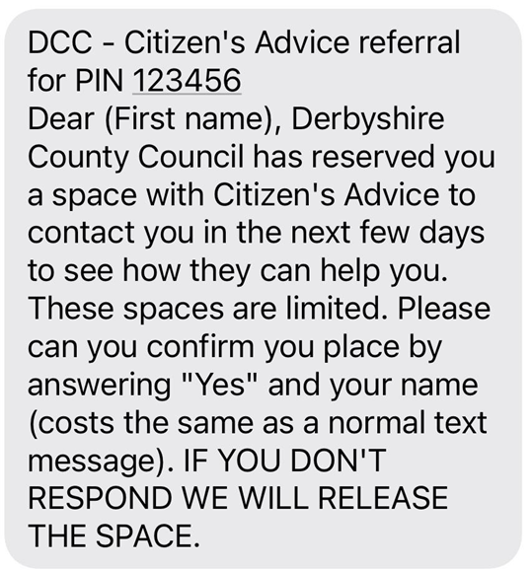
Citizen’s Advice Trial
Project Set Up
Defined the profile of caller CA wanted.
No complex issues
Broad range of issues
Qualified / Engaged applicants
Trial
A commitment device to
reduce the drop out of referrals
to reduce staff time spent ‘chasing’ referrals
The referral was conditional on applicants responding to the SMS
SMS - sent +24 hours after the call
Sample of 610 was required to conduct an RCT.

Slide 8
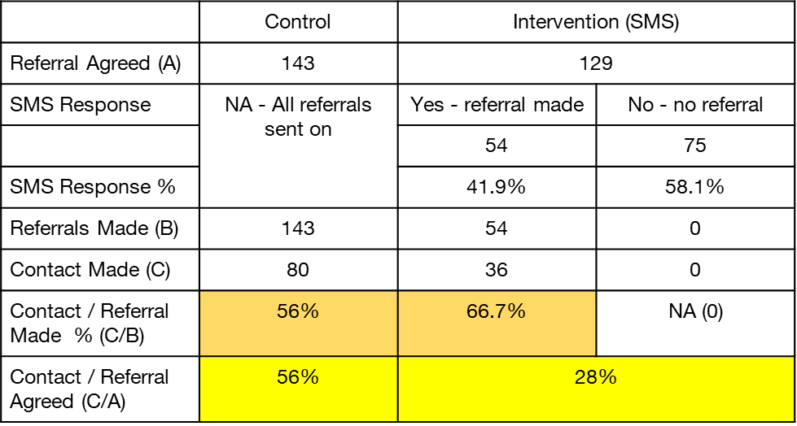
Citizen’s Advice trial results
The CAB trial was run from the 11th May 2021 to the 9th November 2021.
Stopped early as the data showed SMS intervention was acting as a barrier to referral take up.
The SMS intervention reduces the likelihood of callers making contact with CAB at a 99.9% confidence level.
The value of z is 4.6614. The value of p is < .00001. The result is significant at p < .01. Two tailed z-test
Responding positively to the SMS text increases the likelihood of callers taking up the referral was marginally significant with 90% confidence.
The value of z is 1.3617. The value of p is .08692. The result is significant at p < .10. One tailed z-test.

Slide 9
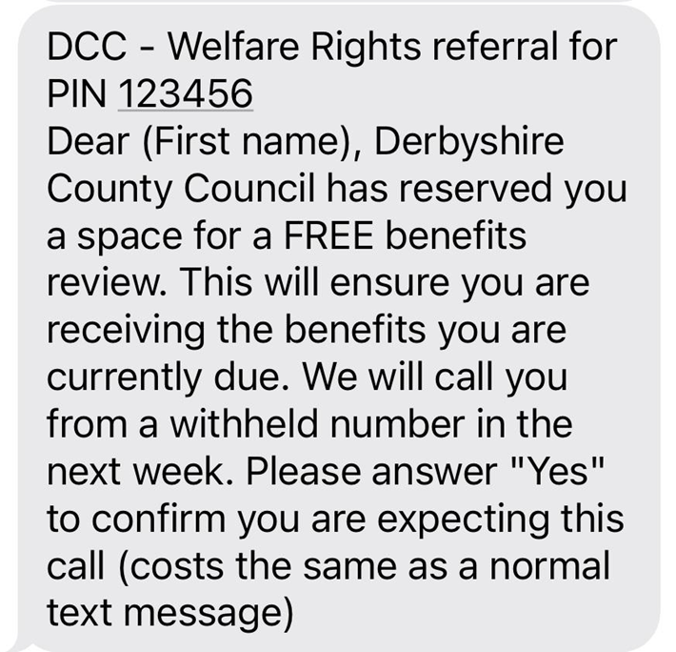
Welfare Rights Trial
Working in concert with Citizens Advice Trial
Same set up as CA.
The SMS was used as a reminder, recipients do not need to confirm to be referred.
SMS Sent after the referral. Response was recorded.
Wider access to data as an internal service

Slide 10
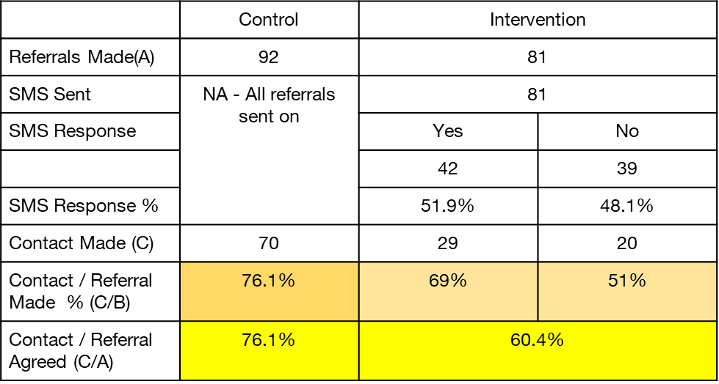
Welfare Rights trial results
The WR trial was run from the 22nd April 2021 to the 22nd Feb 2022.
The trial was stopped early again because of the negative impact of the SMS on referral take up.
The SMS intervention reduces the likelihood of callers making contact with WR at a 95% confidence level.
The value of z is -2.223. The value of p is .02642. The result is significant at p < .05.
Responding positively to the SMS text increases the likelihood of callers taking up the referral. This was marginally significant with 90% confidence.
The value of z is 1.6341. The value of p is .05155. The result is significant at p < .10. One tailed z-test.

Slide 11
SMS trial conclusions
The SMS acts as a barrier to the take up of the referrals.
Correct to stop the trials - Given DDF goals and the goals of the project - increasing support to vulnerable residents.
We believe the reasons for these results could include:
Any extra step requiring effort results in drop-out. Complexity adds confusion.
Increase in SMS fraud during the period of the trial - reduces trust (increase 700%)
We changed the screening process / DM - Callers are only being referred when engaged. The need for a commitment device has been reduced.
SMS has proved challenging for DCC in other contexts, for school holiday food vouchers, 15% of payments made by SMS were initially unclaimed, despite this being a direct payment to recipients.
BUT for those who did respond to the CAB SMS it did act as a commitment device - increasing referral take up. Marginally significant, if the trial had gone on probably a significant finding

Slide 12
Reflections
Challenges:
Covid impact on services resulted in a longer set up time
RCT challenging to put something in place that was practical – couldn’t focus on screening process
Hard to identify and measure outcomes for a control group
Ethics and informed consent difficult with a cohort at the point of financial crisis
Adherence to process by case assessors was an issue – lower than expected sample size
Long term outcomes difficult to capture

Slide 13
Reflections
Benefits:
RCT over pre/post as there were constant changes throughout the trial period – new staff, new funding streams, massive increase in demand
Infrastructure now in place for future test and learn
Learnt what didn’t work and responded in a timely fashion

